Slide 1
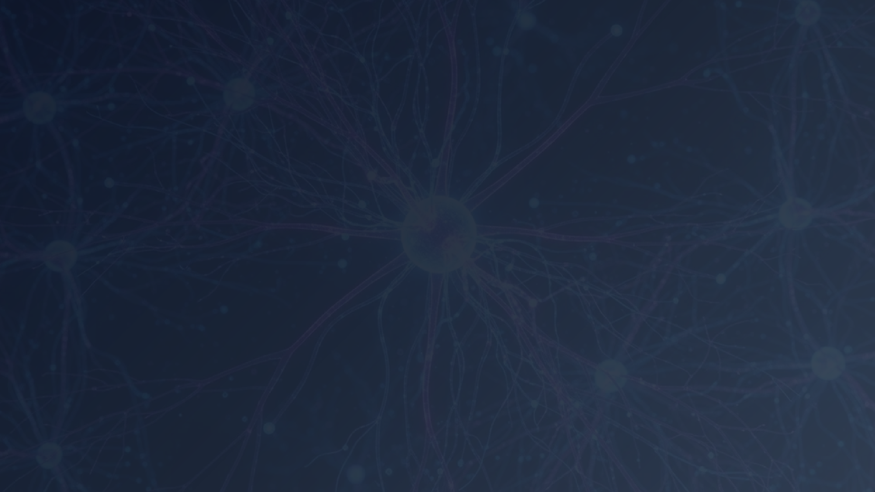

Brain Tumor Detection
Programming for AI (ABAI5003L)
Submitted by: Sourabh (A25MTAI0007)
Submitted to: Dr. Shakshi Sharma
School of Artificial Intelligence
Bennett University | July-Dec 2025

Slide 2
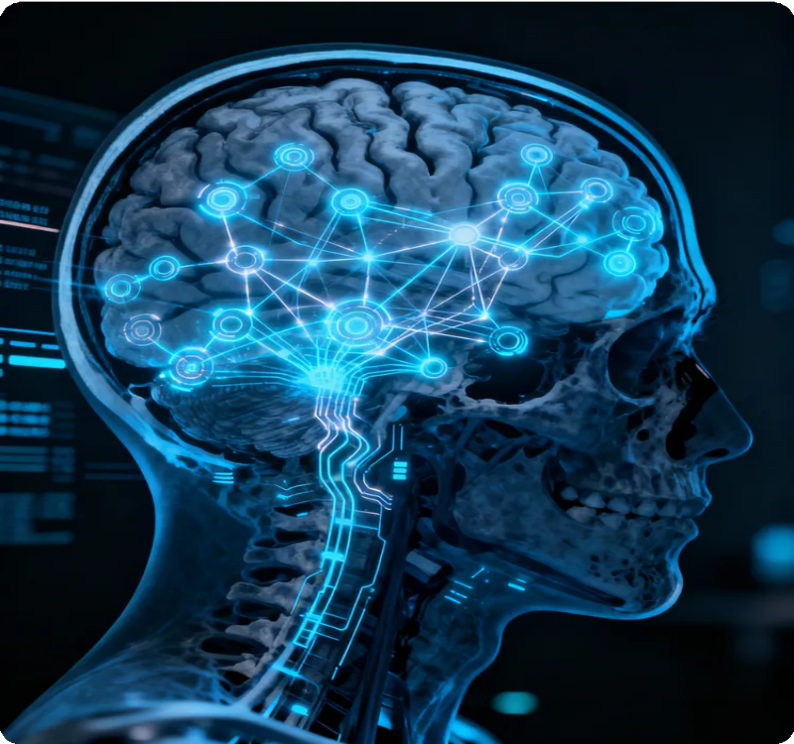
Abstract

Challenge
Manual MRI diagnosis is time-consuming and prone to human error, requiring precise and fast automated solutions.
 AI Solution
Deep learning with VGG16 CNN architecture using transfer learning to automatically classify brain tumors from MRI images.
 Methodology
Comprehensive preprocessing pipeline including resizing, normalization, noise reduction, and data augmentation for enhanced model robustness.
 Clinical Impact
Fast and reliable preliminary screening to assist radiologists, reducing diagnosis time and improving treatment planning.

Slide 3
Introduction
⚠ Challenges in Manual Diagnosis
 AI & Deep Learning Solution
Visual fatigue and human error in interpretation
CNNs excel at pattern recognition in medical images
Subtle tumor boundaries diﬃcult to detect
VGG16 architecture for hierarchical feature extraction
Overlapping tissue structures complicate analysis
Transfer learning leverages pre-trained ImageNet weights
Limited access to expert radiologists
End-to-end learning without manual feature engineering
Time-consuming manual examination process
Fast, automated preliminary screening support
 Project Objective: Develop an automated brain tumor detection system using VGG16 CNN for accurate MRI classiﬁcation

Slide 4




Methodology



Dataset Acquisition
Data Preprocessing
VGG16 Architecture
Source: Kaggle MRI Dataset
Resizing: 128×128×3 pixels
Transfer Learning: Pre-trained on ImageNet
Structure:
Normalization: Pixel values 0-1
Training Folder Testing Folder
Augmentation:
Custom Head:
Contrast adjustment Random zoom in/out Brightness variation
Global Average Pooling Dense Layer (ReLU) Dropout (0.2)
Softmax Output
4 Classes: Glioma
Meningioma Pituitary
No Tumor
Enhances model robustness
16-layer deep CNN

Slide 5

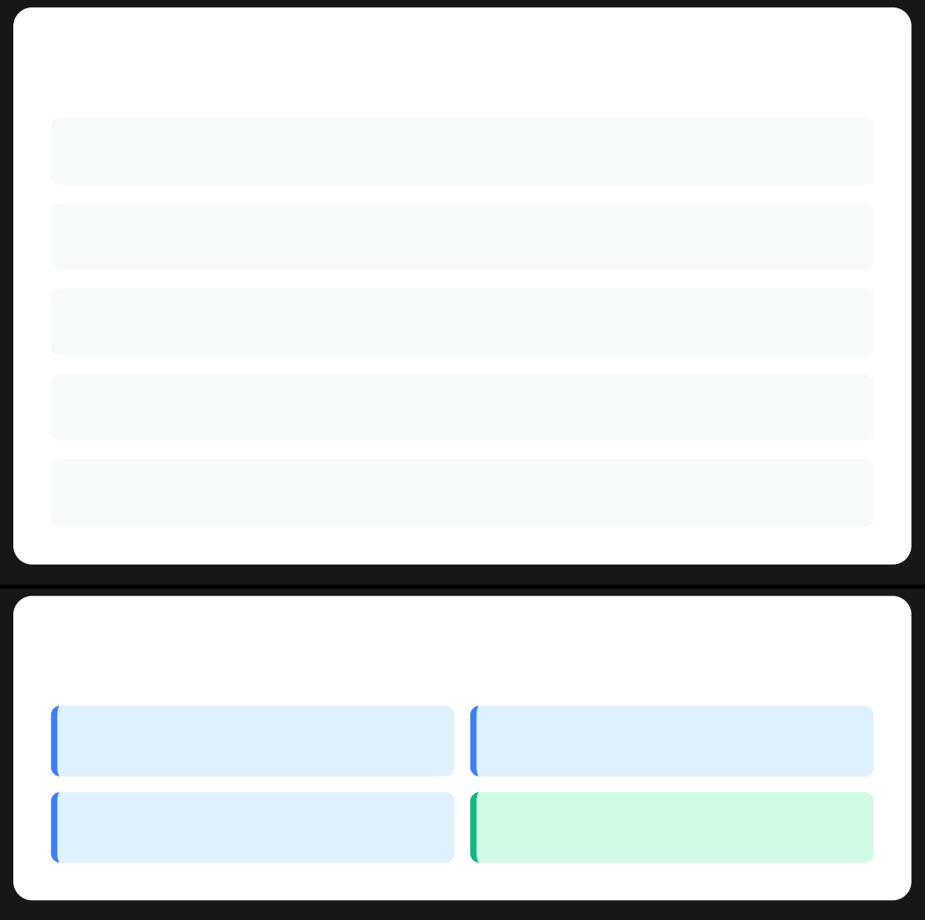


Model Training & Architecture
VGG16 Architecture
⚙ Training Conﬁguration
Optimizer
Adam
 VGG16 Base
Learning Rate
0.0001
Global Average Pooling
Loss Function
Categorical Cross-Entropy
Dense Layer (ReLU)
Batch Size
20
Dropout (0.2)
Epochs
20
 Softmax Output (4 Classes)
 Classiﬁcation Classes
Glioma
Meningioma
Pituitary
No Tumor

Slide 6
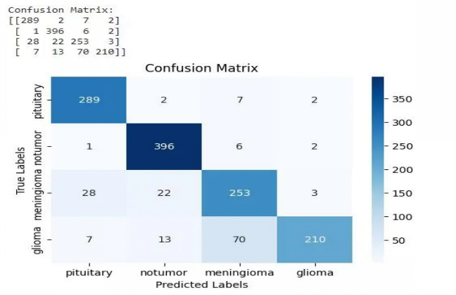
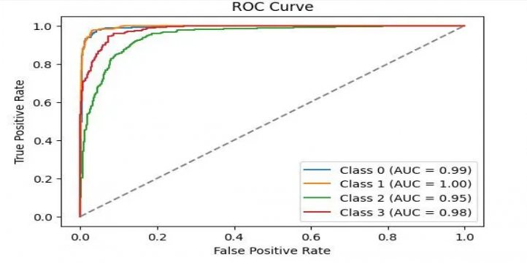
Model Evaluation & Results
 Classiﬁcation Report
 Confusion Matrix
Class | Precision | Recall | F1-Score
Pituitary | 0.89 | 0.96 | 0.92
No Tumor | 0.93 | 0.89 | 0.91
Meningioma | 0.85 | 0.86 | 0.85
Glioma | 0.86 | 0.79 | 0.82
Overall Accuracy |  | 88%
 ROC Curves - Excellent Performance
1.00
Class 1 AUC
Perfect Classiﬁcation
0.99
Class 0 AUC
Near Perfect
0.98
Class 3 AUC
Excellent
0.95
Class 2 AUC
Very Good

Slide 7

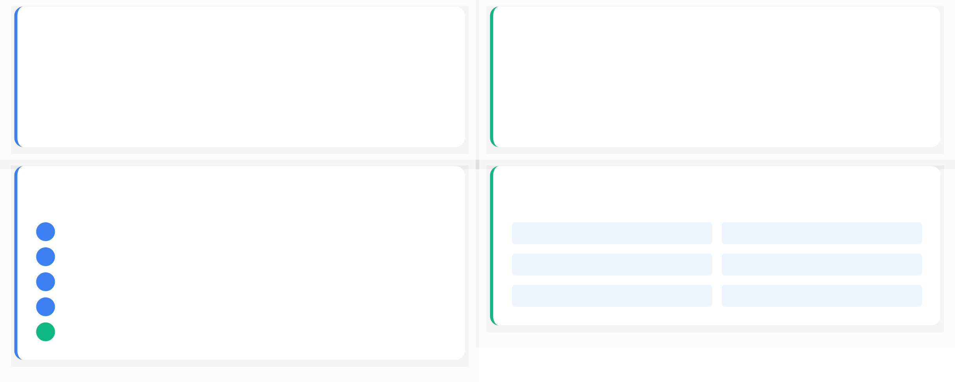
Deployment & System Integration
 Python Deployment |  | Hardware Requirements
 Uniﬁed script (main.py) for model loading & prediction |  | GPU: NVIDIA T4/P100/RTX
 Gradio web interface for easy image upload |  | RAM: 8-16 GB
 Real-time predictions: <1 second | ▪ | Storage: Minimum 2 GB
 System Workﬂow
 Software Stack
1
Dataset Collection
 Python 3.10
 TensorFlow 2.x
2
Data Preprocessing
 Keras
 NumPy/Pandas
3
Model Development (VGG16)
 OpenCV
 Matplotlib
4
Training & Evaluation
5
Deployment & Prediction
7

Slide 8

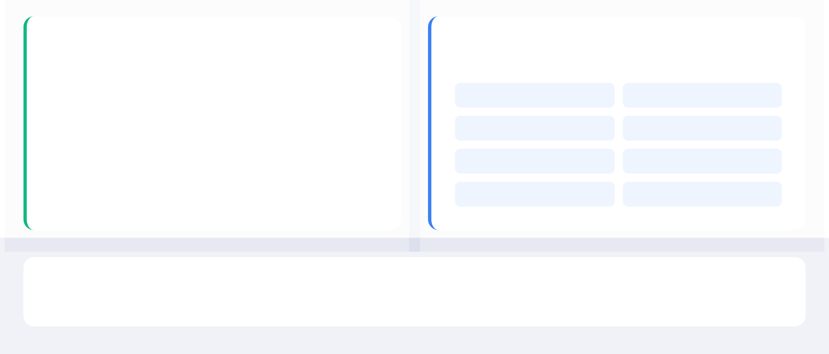
Conclusions & Future Scope
 Key Conclusions
 Future Directions

VGG16-based model achieves 88% accuracy with high reliability
 | Multi-class Detection | ✀ | U-Net Segmentation
■ | Explainable AI (XAI) |  | Larger Datasets
 | Mobile Application |  | PACS Integration
 | GAN-based MRI |  | RL Automation
⇨
Provides fast, automated second opinion for radiologists

Complete end-to-end pipeline from data to deployment

Complete Project Repository
github.com/SourabhHooda/Brain-Tumor-Detection


Slide 9
Conclusions & Future Scope
 Key Conclusions
 Future Directions

VGG16-based model achieves 88% accuracy with high reliability
 | Multi-class Detection | ✀ | U-Net Segmentation
■ | Explainable AI (XAI) |  | Larger Datasets
 | Mobile Application |  | PACS Integration
 | GAN-based MRI |  | RL Automation
⇨
Provides fast, automated second opinion for radiologists

Complete end-to-end pipeline from data to deployment

Complete Project Repository
github.com/SourabhHooda/Brain-Tumor-Detection


